Slide 1

LIFE AND WORK Of SALIM ALI
Presented
by
Jogeswara Rao.

Slide 2
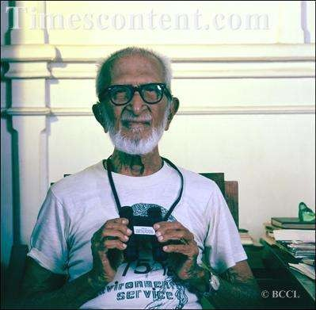
SALIM ALI
Name:- Salim Moizuddin Abdul Ali.
Birth:- 12 November, 1896.
Death:-20 June,1987.
Born In: Khetwadi, Mumbai, Maharashtra. Nationality:- Indian.
Profession:-Ornithologist and Naturalist. Awards:- Padma bhushan, Padma Vibhushan
Known as:- "Birdman of India"

Slide 3

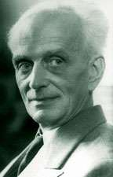
EDUCATION
Matriculation: Bombay University (1913).
Left studies and went to Burma.
Returned to India (1917) he decided to continue formal studies.
Bombay University
B.Sc Zoology: at St. Xavier's College. (under Prof.J.P.Mullan and Prof E. Blatter).
Special Training: Berlin University Zoological Museum, Prof. Ervin Stresemann
Prof. Ervin Stresemann

Slide 4

INTERESTS
Salim Ali have a passion about studying birds in detail.
Salim Ali had interests in playing cricket and hunting.
Fascinated by motorcycles having Sunbeam, Harley-Davidsons (three models), and others.
His interest was in studing "living bird in their natural
environment."

Slide 5
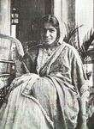
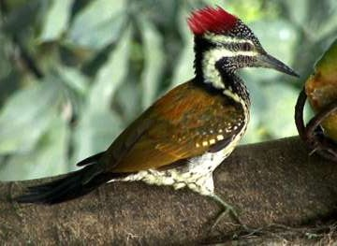
SALIM ALI’S WIFE TEHMINA
Dec. 1918, Salim Ali married Tehmina, a learned scholar from England.
Tehmina help him to improve his English prose.
In 1939, Tehmina died.
Her death was one of the greatest tragic experiences of Salim Ali, but, perhaps it drove him deeper into the world of birds.
The Woodpecker, first collected in Kerala by Ali, is named after his wife, Tehmina , Dinopium benghalense tehminae.

Slide 6

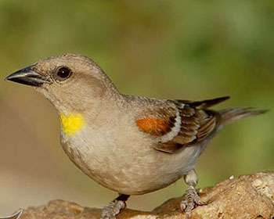
FIRST STEP
Interested in books on hunting.
Yellow-throated Sparrow (Petroia xanthocollis) event (1908) as the turning point.
Salim was introduced to the serious study of birds by W. S. Millard, secretary of Bombay Natural History Society (BNHS).
Journey of collection and study begins.

Slide 7
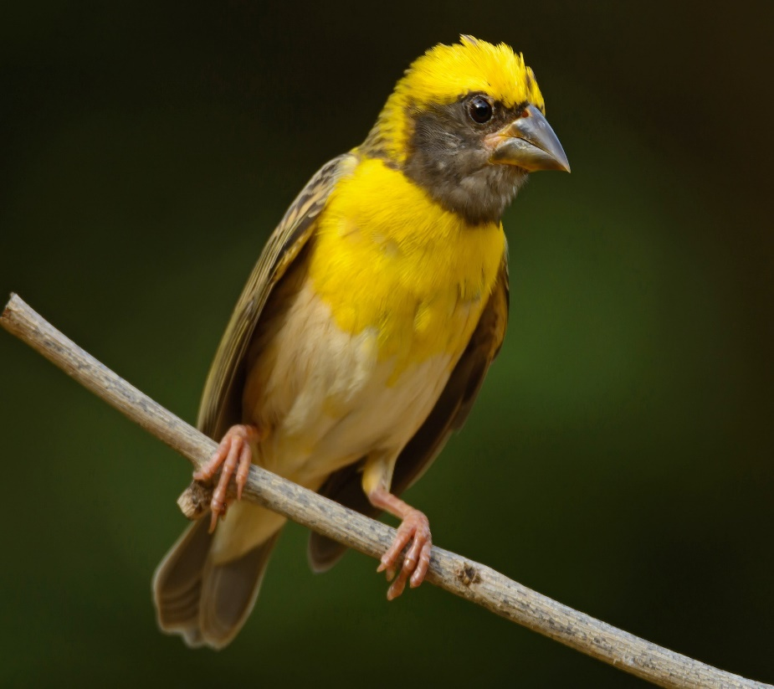
SINGLE EVENT WITH GREATEST PLEASURE
His work on nesting habit of Weaver bird is done after his return from Germany 1931.
He and his wife moved to Kihim, a coastal village near Mumbai.
Study the breeding of the Weaver bird.

Slide 8
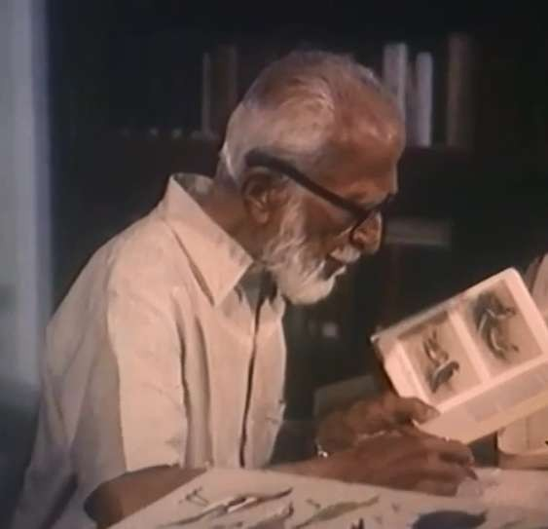
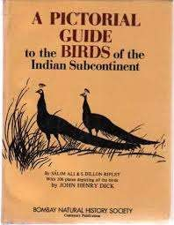
Literary career
Salim Ali was a prominent writer, he penned number of books, scientific studies, and research papers.
Books
Handbook of the Birds of India & Pakistan (1964-1974).
Common Indian Birds (1968).
Hamare Parichit Pakshee (1969).
Bird Study in India (1979).
The Great Indian Bustard (1982).
A Pictorial Guide to the Birds of the Indian Subcontinent with Dillon Ripley, Bombay: OUP (1983)
The Fall of a Sparrow (1985).
The Book of Indian Birds (1996).

Slide 9
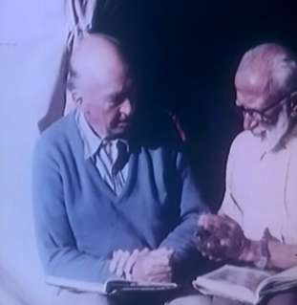
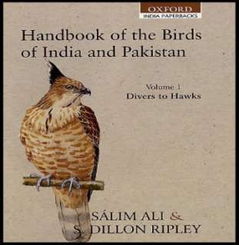
Dillon Ripley & Salim Ali
Dillon Ripley is a close friend of Salim Ali.
They are joint authors of “Handbook of the Birds of India and Pakistan" published in 1964 - 1974.
This book has 10 volumes describing more then 2000 birds species and sub-species of indian subcontinent.
This book laid the foundation of indian bird life.
S. Dillon Ripley & Salim Ali

Slide 10
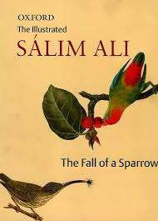
THE FALL OF A SPARROW
Salim record his evolution from a young school boy to a celebrated ornithologist.
It contains memorable bits about Salim’s life, his influences, his travels and his activities.
The journey in search of some bird, Afghanistan, Flamingo city, and Bharatpur.
The entertainment value of bird watching.

Slide 11
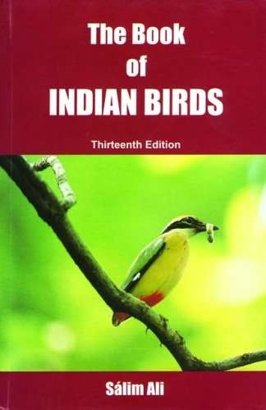
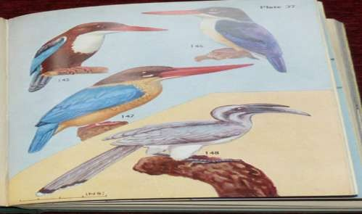
THE BOOK OF INDIAN BIRDS
A wise old Chinese proverb “One picture is worth 10,000 words”
In 1941, with 56 coloured plates depicting 296 species
Birds described in term of size, distribution, habits, food and nesting.

Slide 12
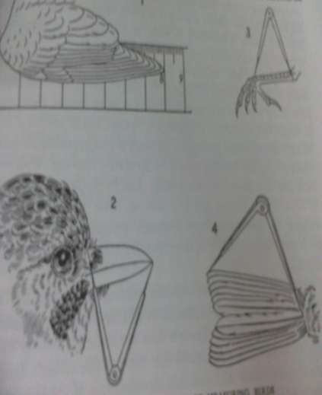
MEASUREMENTS
Under museum diagnosis the measurements given for wing, bill, tarsus and tail by this standard method.
Wing:- Carpal joint to longest feather..
Bill:-By help of divider with one end at culmen and other at tip of beak.
Tarsus:- Knee joint to base of middle toe.
Tail:- End of body to tip of longest feather.
Standard method of measuring birds

Slide 13
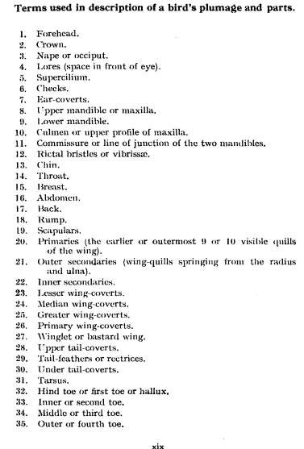
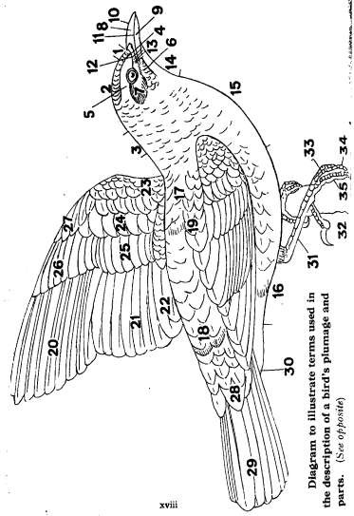
Terminology of Bird’s parts and plumage

Slide 14

BIRDS MIGRATION
Birds migration a fascinating subject to
Salim Ali.
Bharatpur sanctuary is the focal point of BNHS for migration studies which Salim Ali directed during his tenure.
Nearly 250 species are recorded there including Sibarian crane, duck, geese and other birds.
Salim Ali at Bharatpur sanctuary
Every winter the Siberians cranes, and thousands of ducks, geese and other birds come to Bharatpur escape the bitter cold of Siberia and central Asia, from here many migrant dispersed to other part of India.

Slide 15
AWARDS
1953: Awarded with Joy Gobinda Law Gold Medal by Asiatic Society of Bengal.
1958: Received doctorate degree from AMU.
1958: Honored with Padma Bhushan Award.
1970: Bestowed with Sunder Lal Hora Memorial
Medal.
1973: Received honorary doctorate from Delhi University
1976: Conferred upon with Padma Vibhushan Award.
1978: Received honorary doctorate from Andhra University.
1986: Received honorary doctorate from Kerala Agriculture University.

Slide 16
CONCLUSION
Salim Ali scaled new heights in the field of ornithology and, with his matchless dedication.
He left his family business under the influence of curiosity for nature and started journey with a pair of binocular, a notebook, a pencil and an ample stock of patience and dedication.
Which shape him into ‘The Grand Old Man of Indian Ornithology’.
Today if one can identify or differentiate between two birds, it is all because his accurately illustrated reader friendly birds books.
He contributed enormously to the development of Indian Ornithology.

